Slide 1
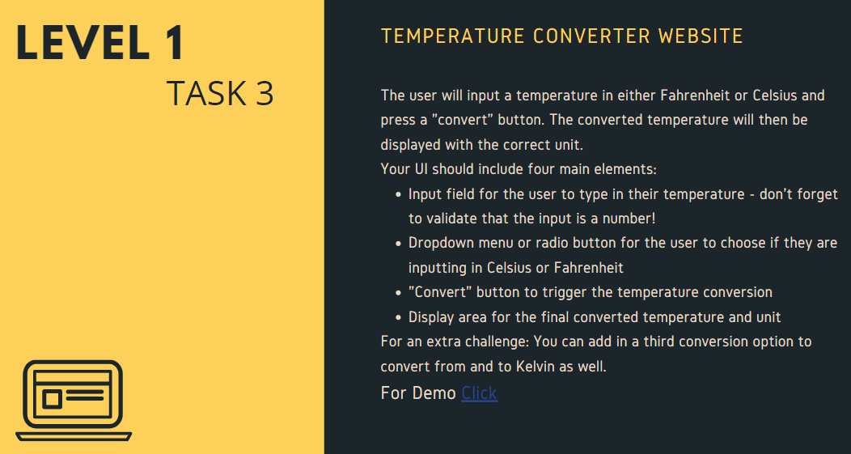
OASIS INFOBYTE
(Web Development And Design Intern)

